Slide 1
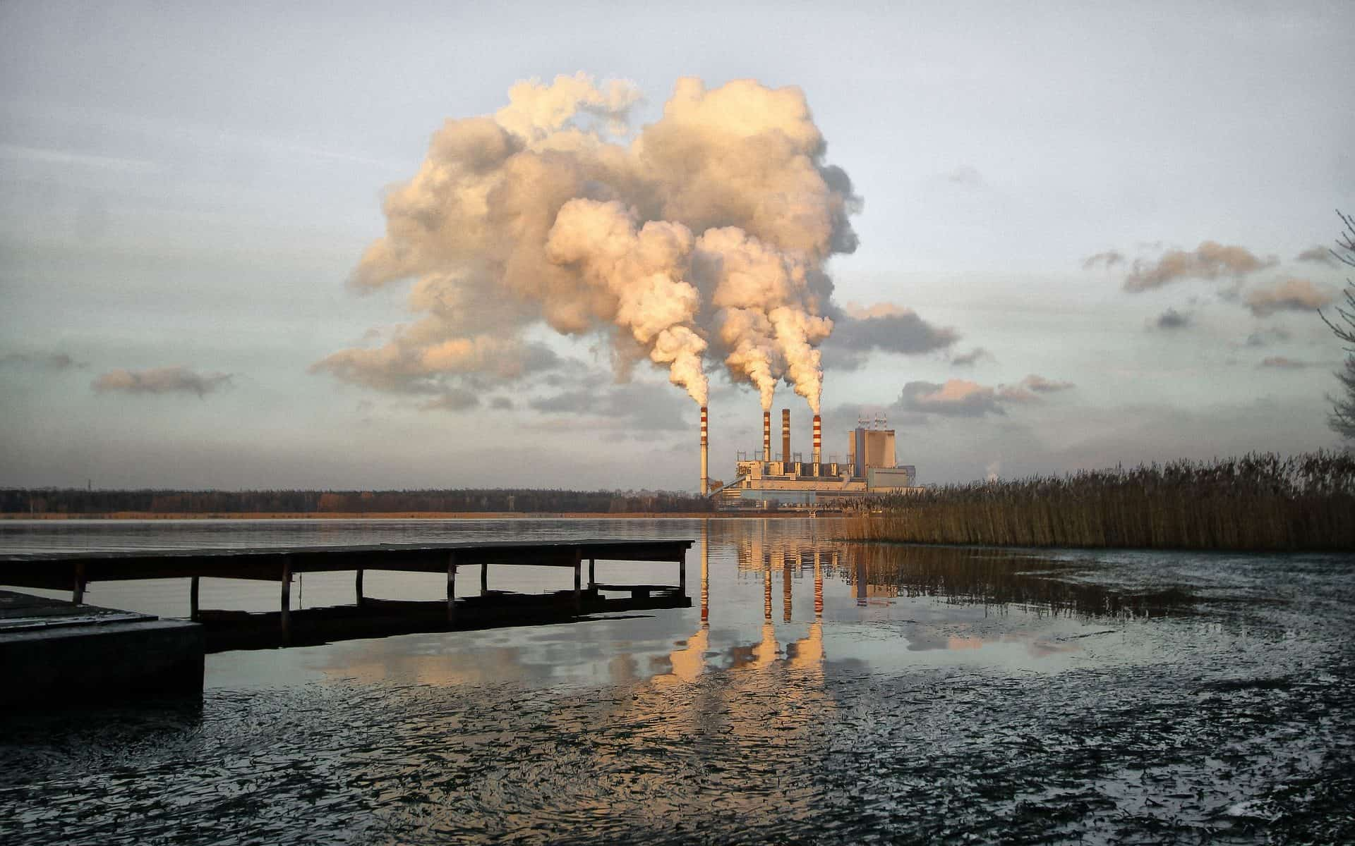
Environmental Pollution
Understanding the Crisis and Seeking Solutions
Presented by:
Sazal Ashraf Khan
ID: SO-02-12

Slide 2
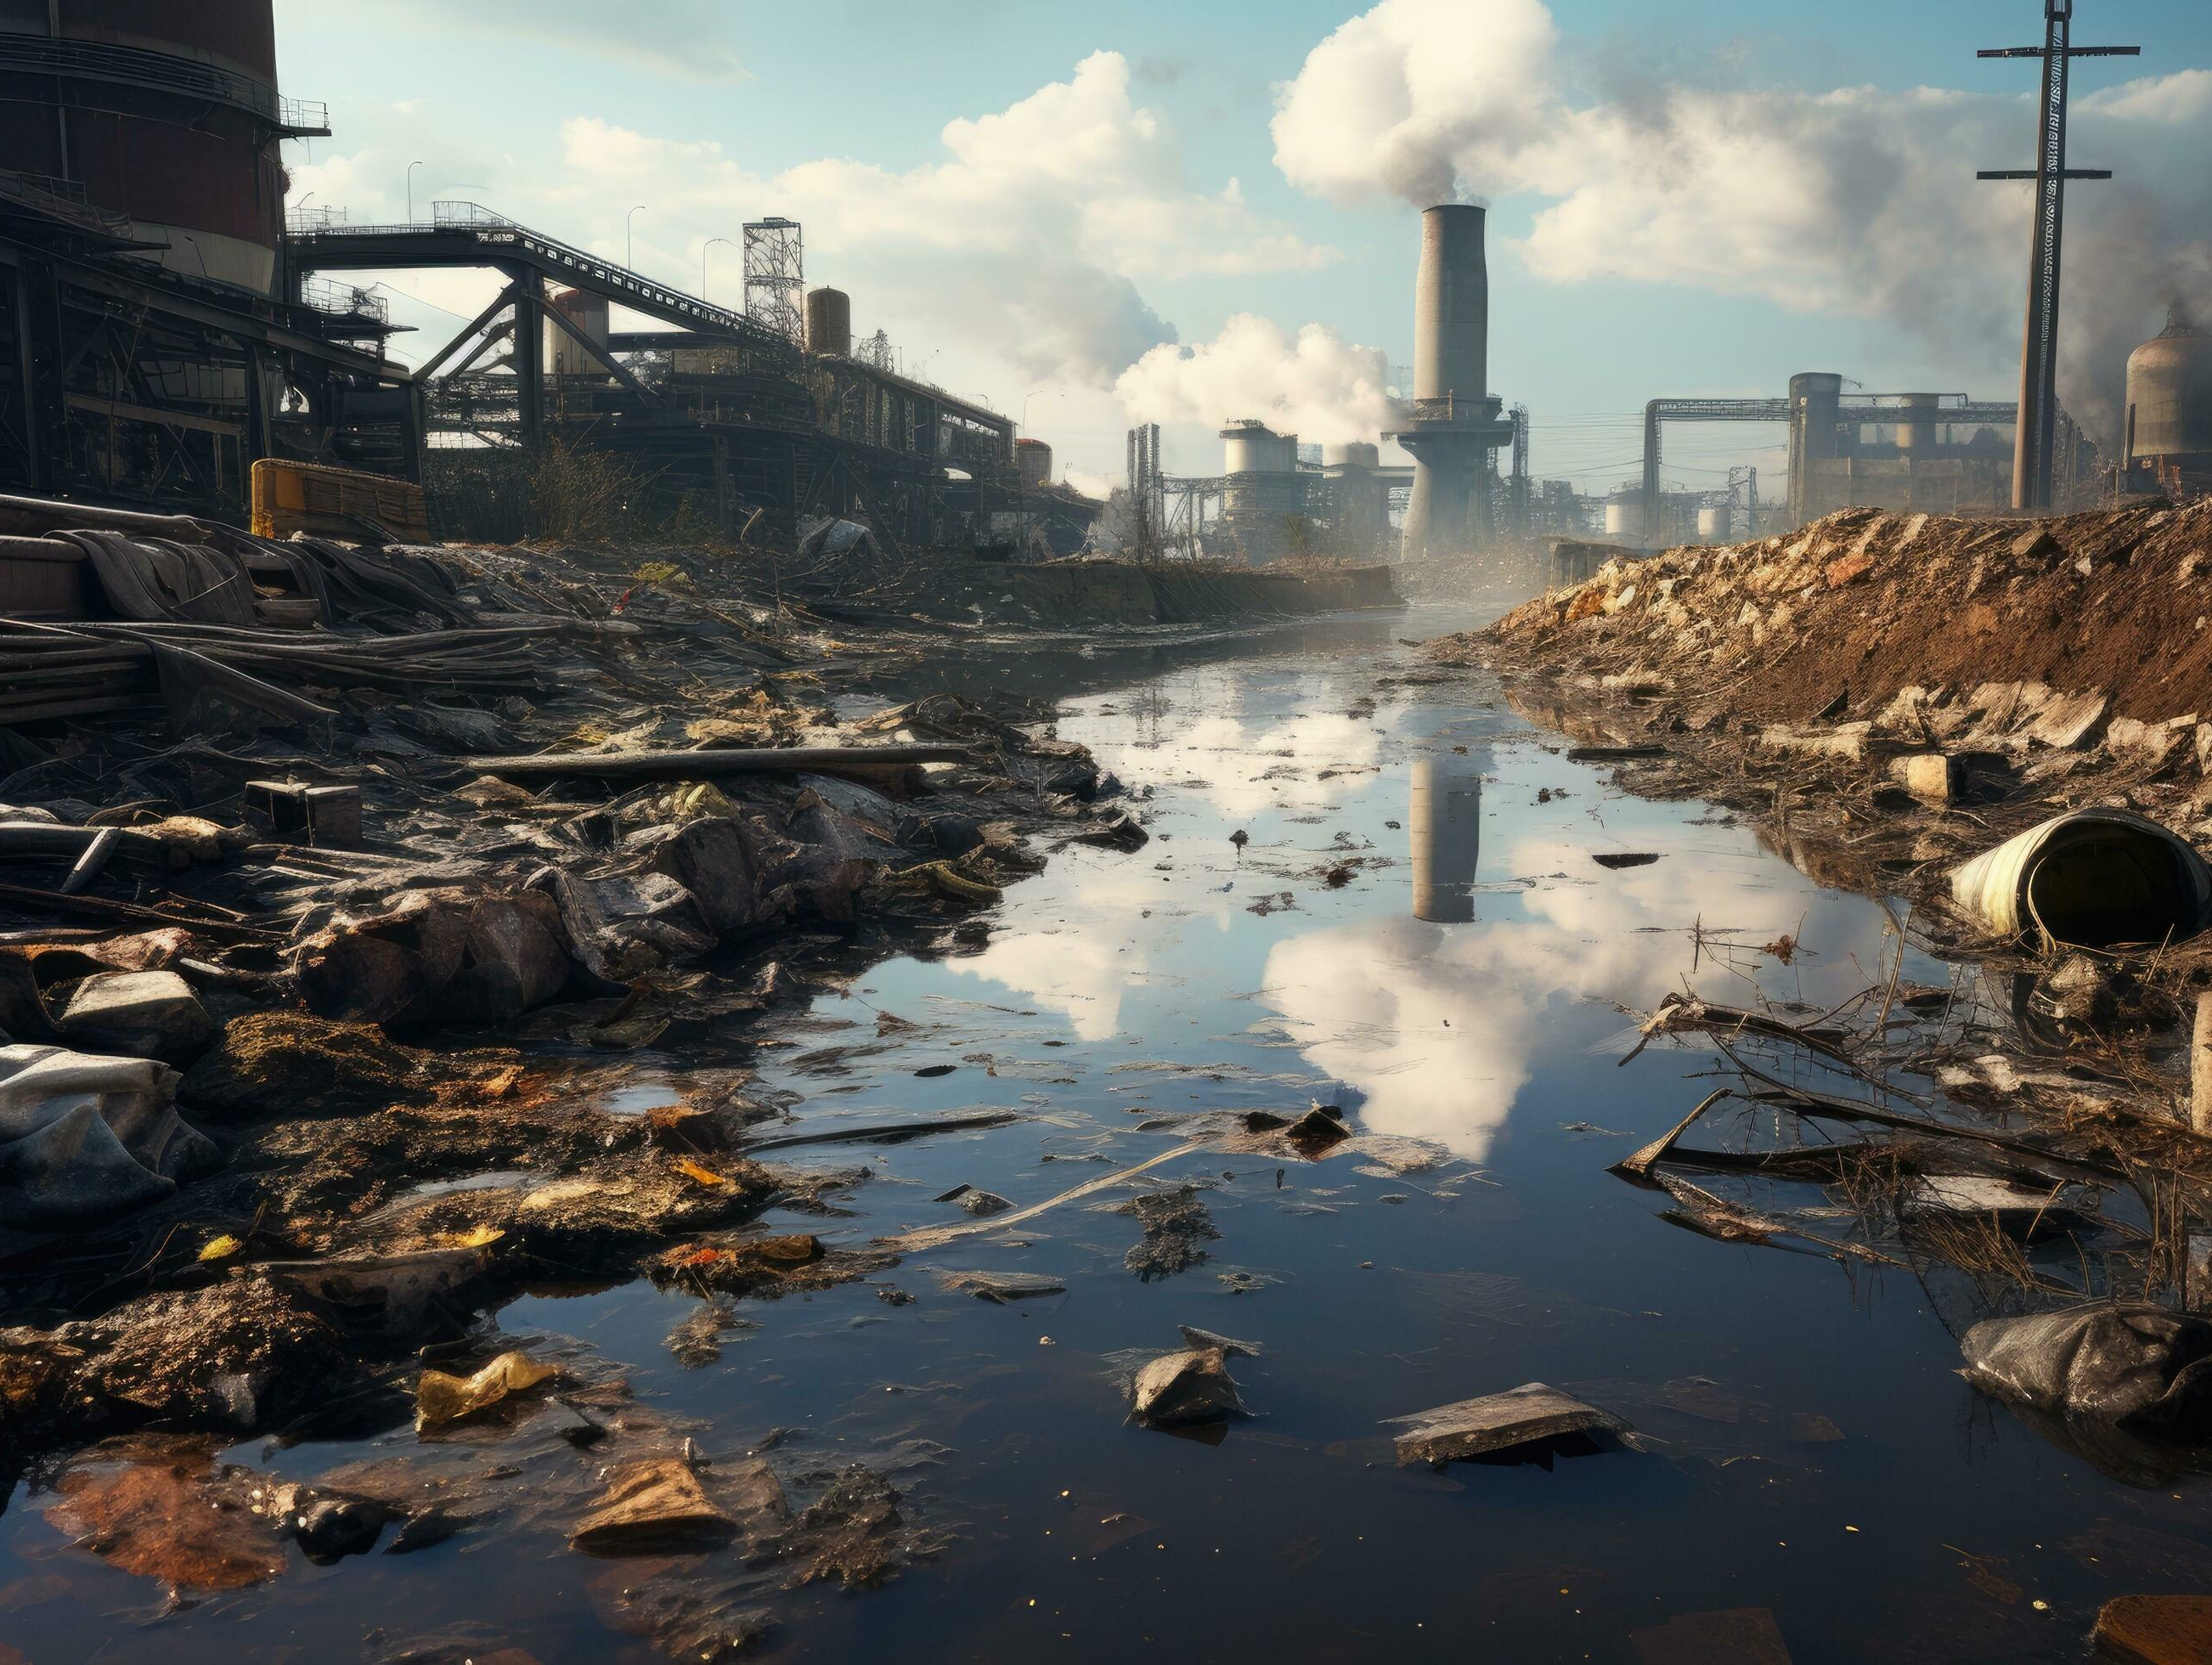
What is Environmental Pollution?
Environmental pollution refers to the contamination of the natural environment by substances or activities that cause harm to ecosystems, human health, and the overall balance of nature. It occurs when pollutants—such as chemicals, waste materials, or energy (e.g., heat, light, noise)—are introduced into the environment at levels that exceed its capacity to absorb, neutralize, or recycle them.

Slide 3
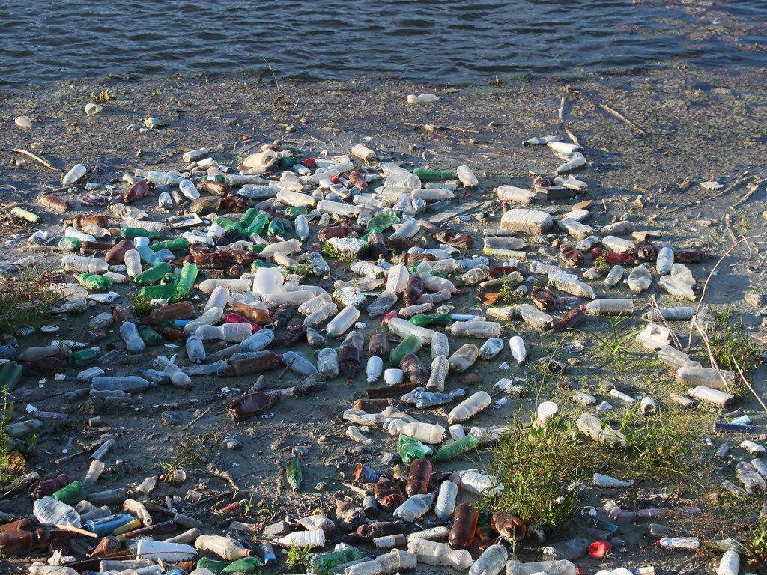
Types of Environmental Pollution
Air Pollution
Soil Pollution
Water Pollution
Noise Pollution

Slide 4
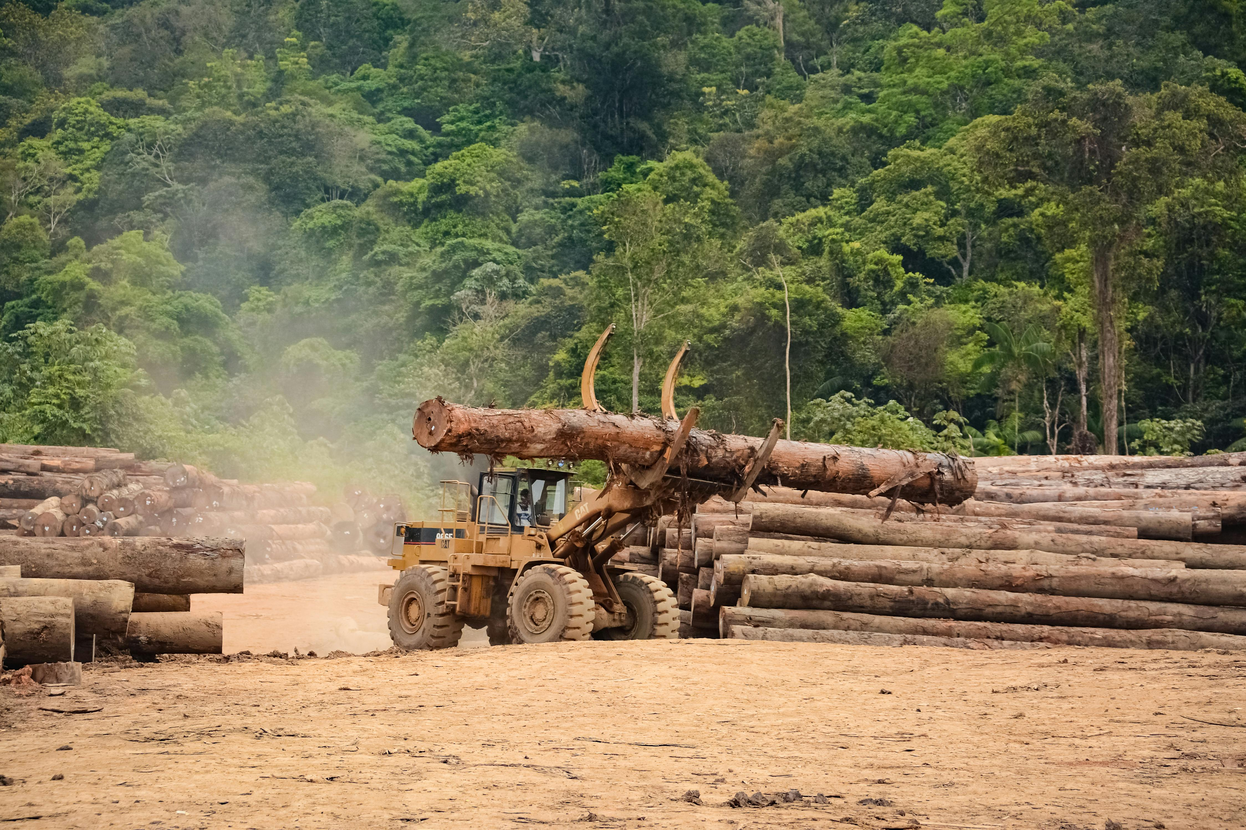
Causes of Environmental Pollution
Industrialization
Deforestation
Over-use of Plastics
Vehicle Emissions
Environmental pollution is primarily caused by human activities that disrupt the natural balance of ecosystems. Industrialization and urbanization release harmful pollutants into the air, water, and soil through emissions, waste, and deforestation. The overuse of fossil fuels for energy and transportation contributes significantly to air pollution and global warming.

Slide 5
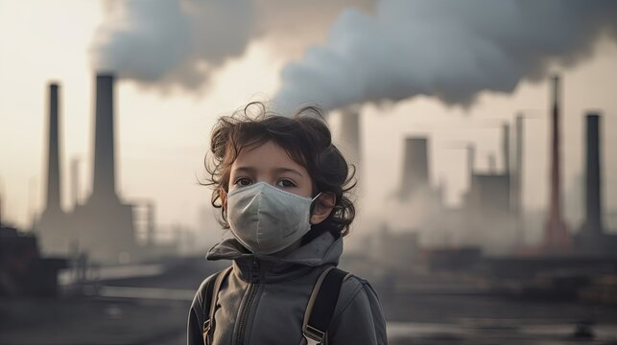
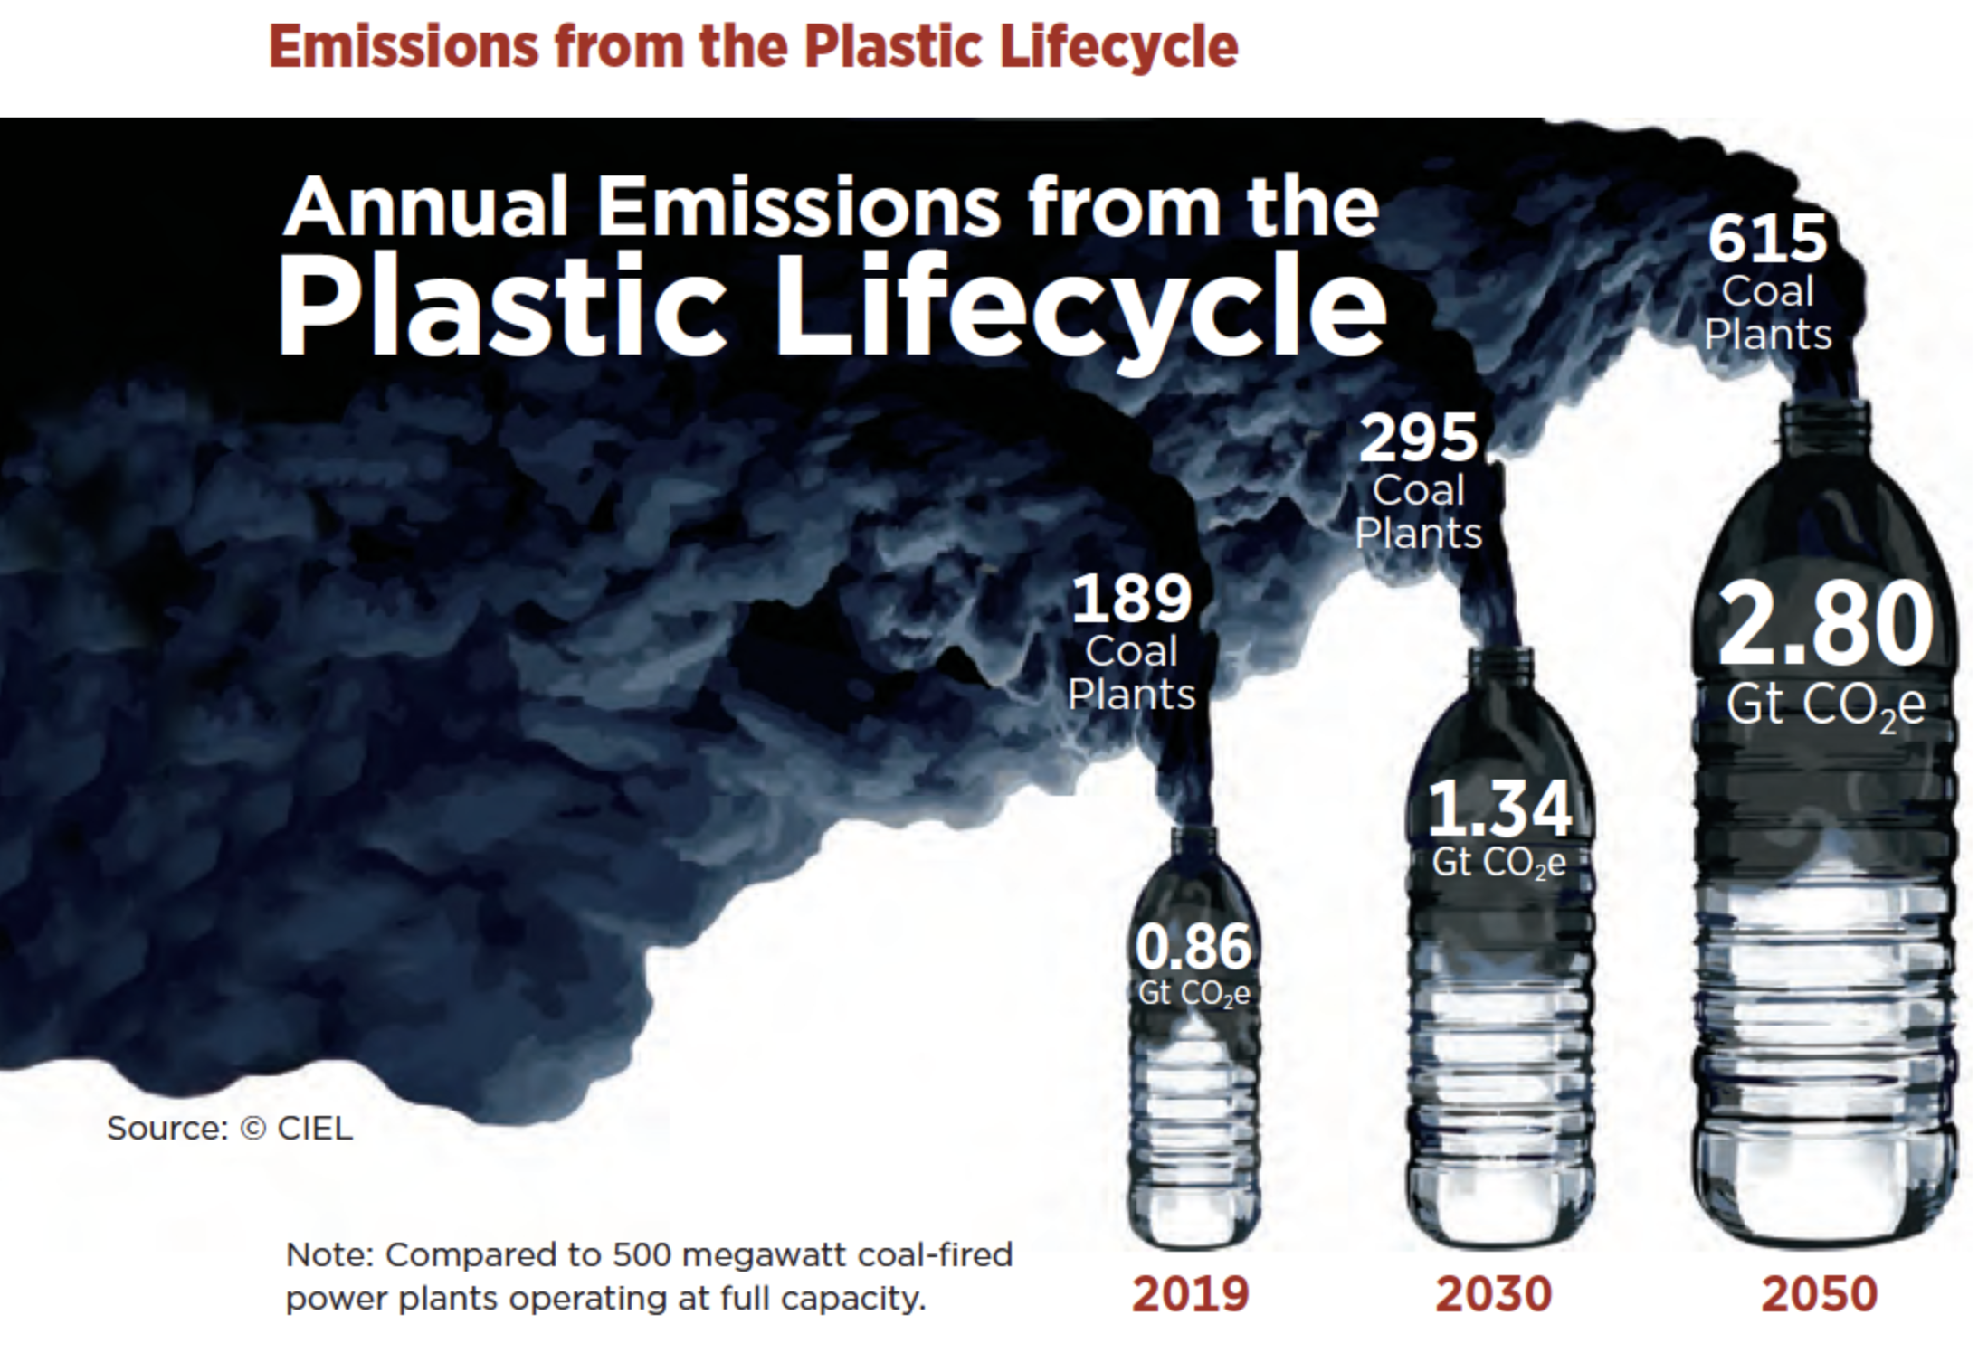
Impacts of Environmental Pollution
On Health
On Environment
On Economy
Respiratory diseases
Cardiovascular issues
Waterborne illnesses
Global warming
Ozone layer depletion
Loss of biodiversity.
Increased healthcare costs
Reduced agricultural productivity
Loss of tourism

Slide 6
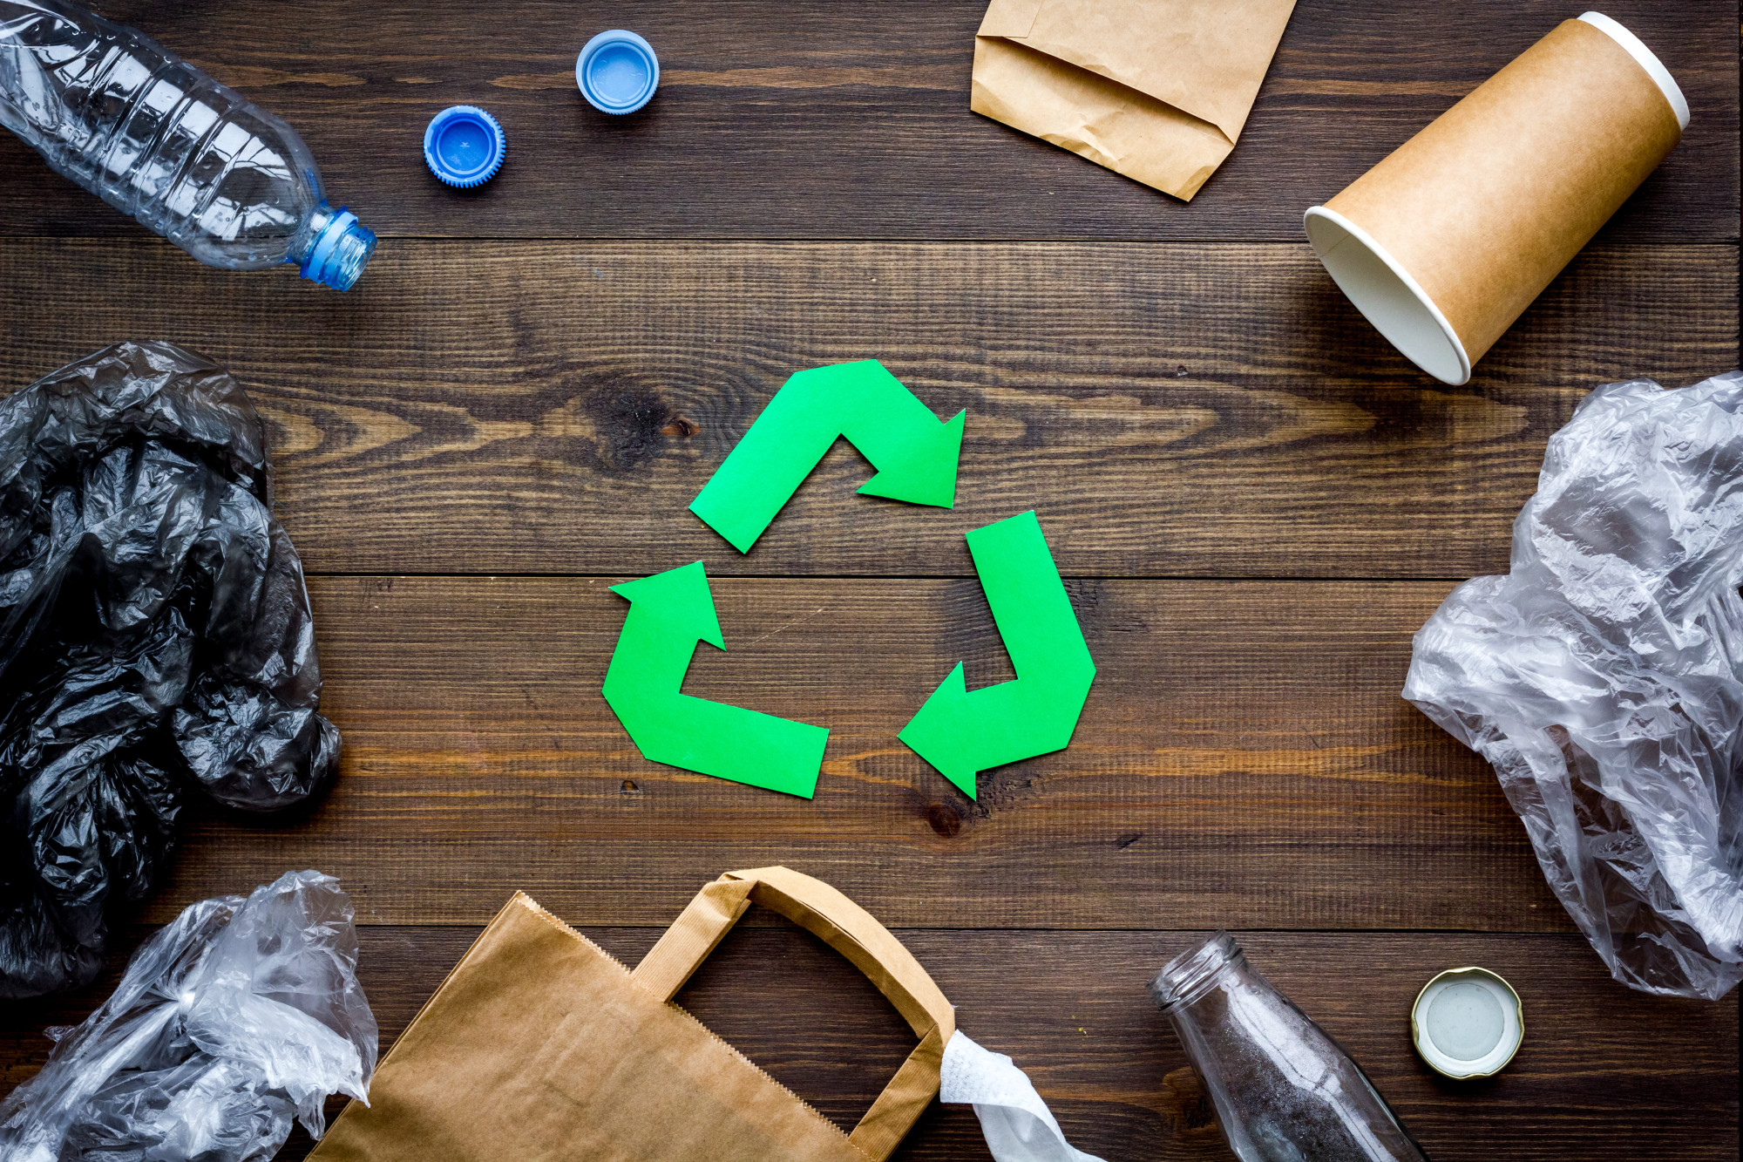
Individual Actions:
Reduce, Reuse, Recycle.
Use public transport or eco-friendly alternatives.
Avoid single-use plastics.
Governmental Measures:
Enforce strict pollution control laws.
Promote renewable energy sources.
Invest in afforestation and conservation projects.
Global Initiatives:
Paris Agreement on climate change.
United Nations' Sustainable Development Goals.
Visual: Green-themed icons representing sustainability efforts.
Solutions to Environmental Pollution

Slide 7
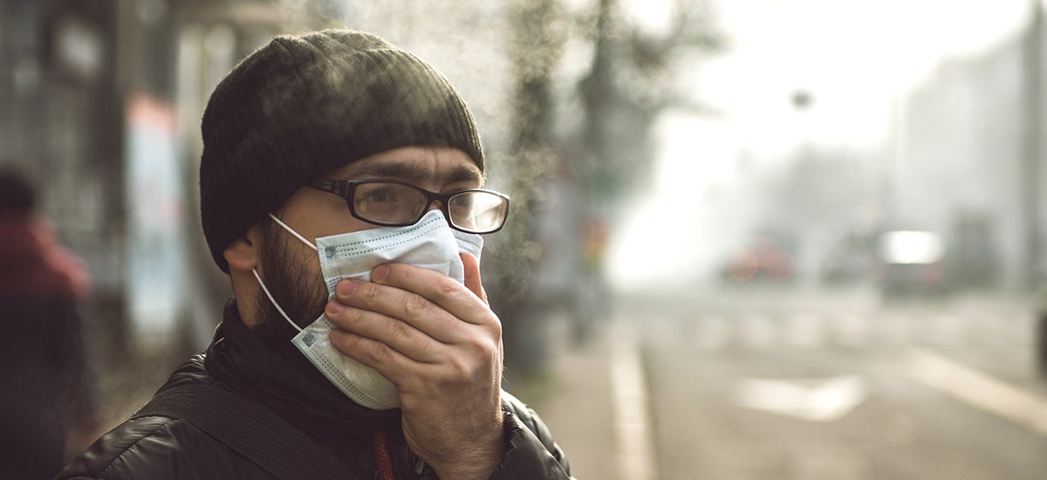
Thank You

